Slide 1
Overview
Visualizing SEMs
Broader context
flexplot
eight steps of data analysis
Need for intuitive graphics
Difficulties with visualizing SEMs
Previous Approaches
My Approach
Examples

Slide 2
Visualizing SEMs
SEMs are inherently untrustworthy
compress information
difficult to assess fit
both globally and locally
most important components cannot be seen
need for visuals
I will introduce tools for visualizing SEMs
But first…

Slide 3
A little history
concerned with SPSS
invited a cursory look at data
R was great, but…
steep learning curve
Goal:
make R easier to use than SPSS
but developed under a different paradigm
started writing “wrapper” functions
thus, flexplot was born

Slide 4
Flexplot
flexplot
an R package
with versions in JASP and Jamovi
future release of JASP: engine that produces all graphics
utilizes formula
automates the plotting
follows scientifically-generated heuristics

Slide 5
Flexplot examples

Slide 6
A Different Approach to Data Analysis
Traditional way
follow decision tree
mechanical steps that lead to an unambiguous (and often wrong) decision
Problems
science is messy
no formula for discovery (or even confirmation)
important information missed
too much faith in result
replication crisis

Slide 7
So what to do?
Cohen -- there is no magical alternative
Interpretation: there’s nothing we can do
Practitioners want a series of steps to follow
Methodologists are concerned they will make a machine out of it
My idea
give them steps that train the mind to seek evidence

Slide 8
Eight Steps
State theoretical hypothesis and decision criteria
Assess psychometrics
Plot univariate distributions
Plot a graphic to match the analysis
Study the residuals
Study parameter estimates/effect sizes
Make a decision based on step 1
Replicate on a new sample

Slide 9
Eight Steps
State theoretical hypothesis and decision criteria
Assess psychometrics
Plot univariate distributions
Plot a graphic to match the analysis
Study the residuals
Study parameter estimates/effect sizes
Make a decision based on step 1
Replicate on a new sample

Slide 10
Furthermore…
Raw data should be plotted
Not summaries of data
Why?

Slide 14
Compression
Numeric statistics compress information
That compression is okay if the model is appropriate
But you can’t know if it’s appropriate if all you see are the numbers!

Slide 15
Do you see the problem?
Every statistical procedure must have a graphic
Every statistical graphic must present raw data
but…

Slide 16
Yet there are advantages
Improves encoding
Highlights misfit
Focus on local fit, rather than global fit
I’ve never trusted SEMs because I cannot SEE them

Slide 17
Structural Equation Models are Invisible!
We are modeling relationships between latent (unobserved) variables
in other words, the raw data are invisible!
AND, SEMs are done on covariances
not raw data (except FIML…ish)
so we can’t plot raw data!
Example datasets
jedi_jedi dataset
stats_jedi dataset
report summary statistics
show visual of latent variables

Slide 18
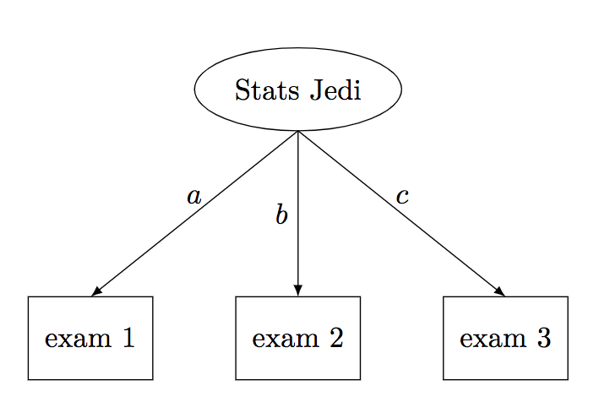
Stats Jedi Example

Slide 19
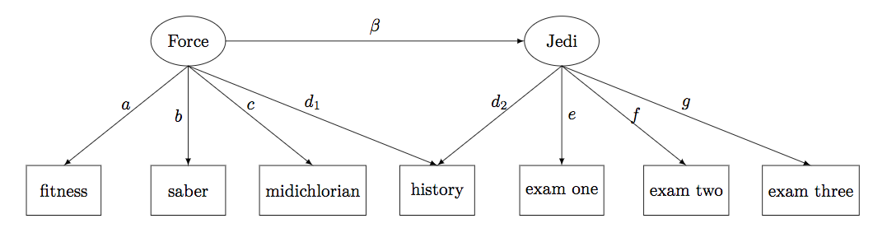
JEDI Jedi Example

Slide 20
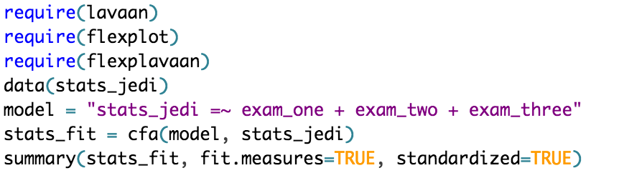
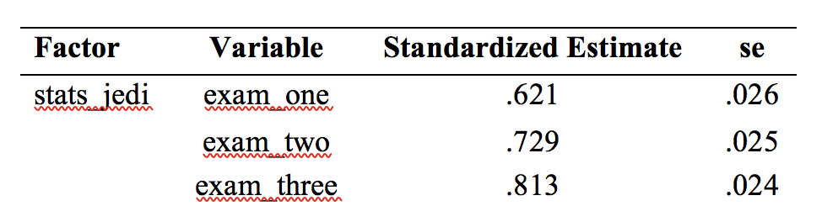
Fit
rmsea < 0.001
cfi = 1
lti = 1

Slide 21
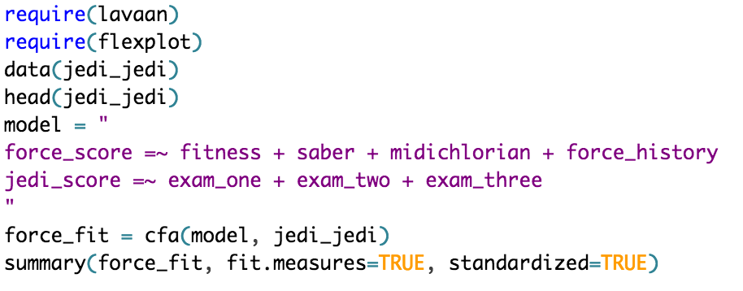
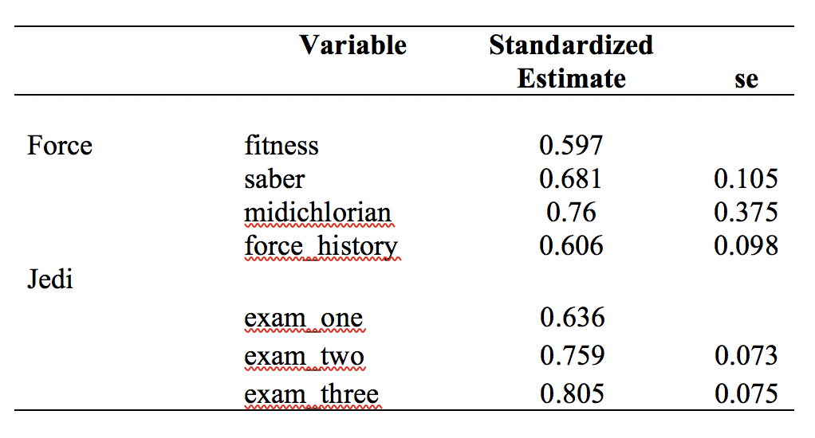
Fit
RMSEA = 0.165
cfi = 0.850
lti = 0.757

Slide 22
Not that people haven’t tried…
Two groups of techniques for visualizing SEMs
Visualizing relationships between latent and observed

Slide 23
Problems…
These assume the model is correct
These assume linear relationships
because they’re based on covariances/means

Slide 24
Visualizing latent scores (Tay, not tay).
compute factor scores for every individual
study relationships between latent variables based on factor scores

Slide 25
What approach do we typically take?
Regression models (e.g., scatterplots)
observed data are the X and Y
we plot the observed data as points
the model is a line (or a large dot or something)
SEM approaches
latent data are the model
the dots are the latent variable
the dots are the model
Let’s get back to the basics
leave the data as the dots
leave the model as the line

Slide 26
Shadow Plots
Plot the items on the x/y axis
The line is the “fit”
or the relationship between x/y, implied by the model
the latent is lurking in the “shadows,” leaving its trace as a line
But how?

Slide 27
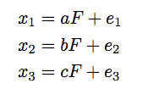
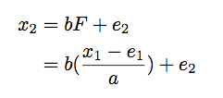
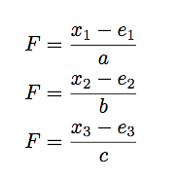
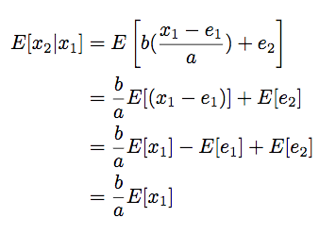
Scary Math
Model-implied equations for variables
Defining x2 in terms of x1
Re-expressed in terms of latent variable
Computing the conditional expectation

Slide 28
Easy as…

Slide 29
In an ideal world…

Slide 30
Not so fast!

Slide 31
Why
SEMs “correct” relationships for unreliability
The fitted line is what we would observe with perfect reliability
But we don’t have perfect reliability!

Slide 32
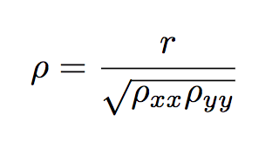
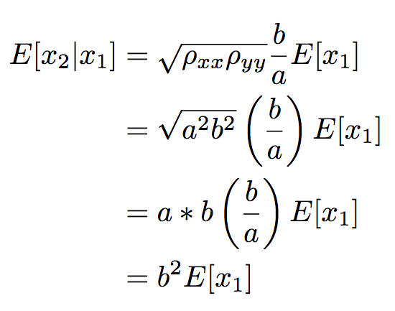
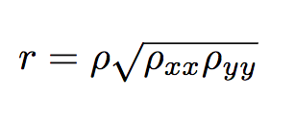
Danger!
Standard correction for unreliability
Plug it in to the previous equation
“Uncorrected” correlation

Slide 33
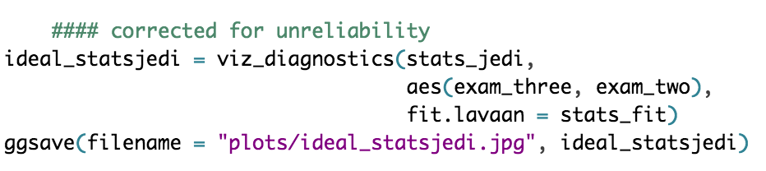
And now we get…

Slide 34
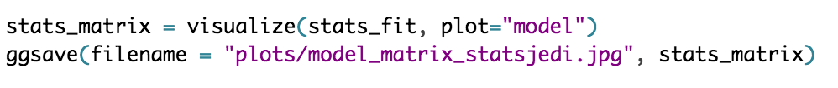
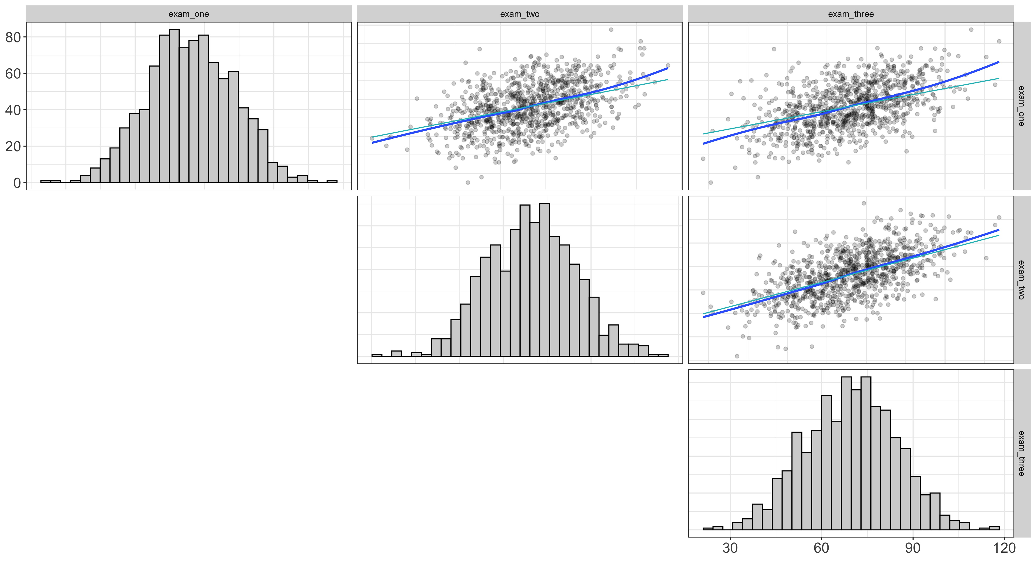
Or see them all…

Slide 35
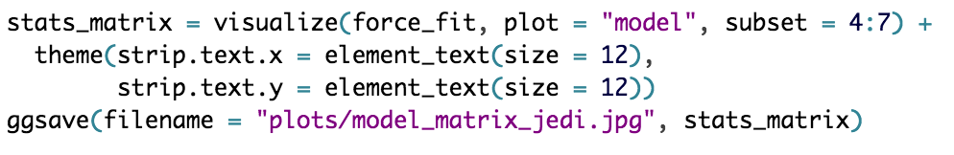
Or see them all…

Slide 36
Shadow plots
Advantages
good diagnostic tool
if the line ain’t going through the data, you know there’s misfit
highlights local misfit
easy to interpret
just standard regression
Disadvantages
may mask misfit
doesn’t improve encoding for the entire model
the math will fail if models are nonlinear

Slide 37
We can also do residual plots
Remember what a residual is
What remains of the DV after we’ve removed the (linear) effect of the IV
geometrically…

Slide 38
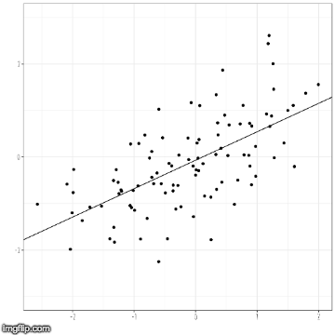
What is a residual?

Slide 39
Disturbance Dependence Plots
Shadow plots give us a “fit”
We can then subtract out the fit to get residuals
but we call them disturbances in SEM
we should have no relationship left
And for our data?

Slide 40
Stats

Slide 41
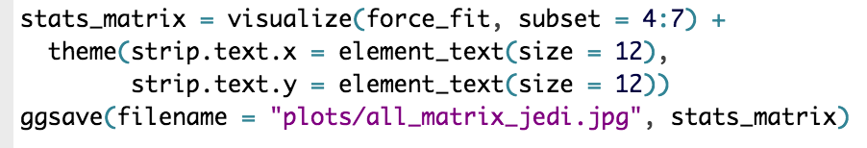
JEDI

Slide 42
Substantive Conclusions
Stats dataset fits quite well
all exams seem to be measuring the same thing
JEDI dataset has some problems
we’re consistently underestimating the relationship between force_history and the three Jedi exams
this suggests we should probably add a crossloading
boy, wouldn’t it be nice if we could visualize the fit of BOTH models??

Slide 43
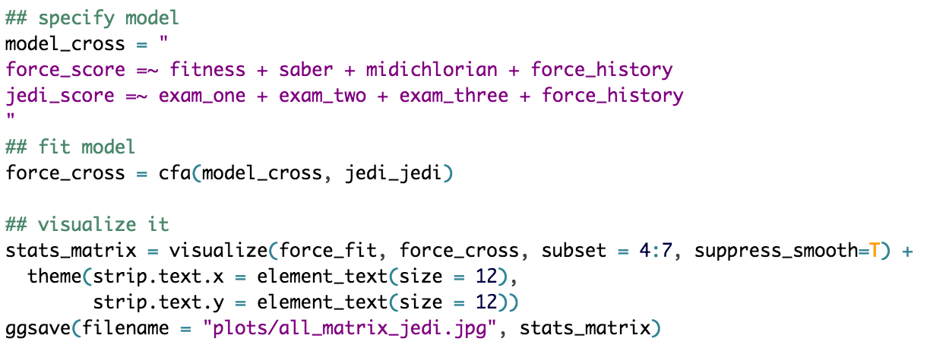
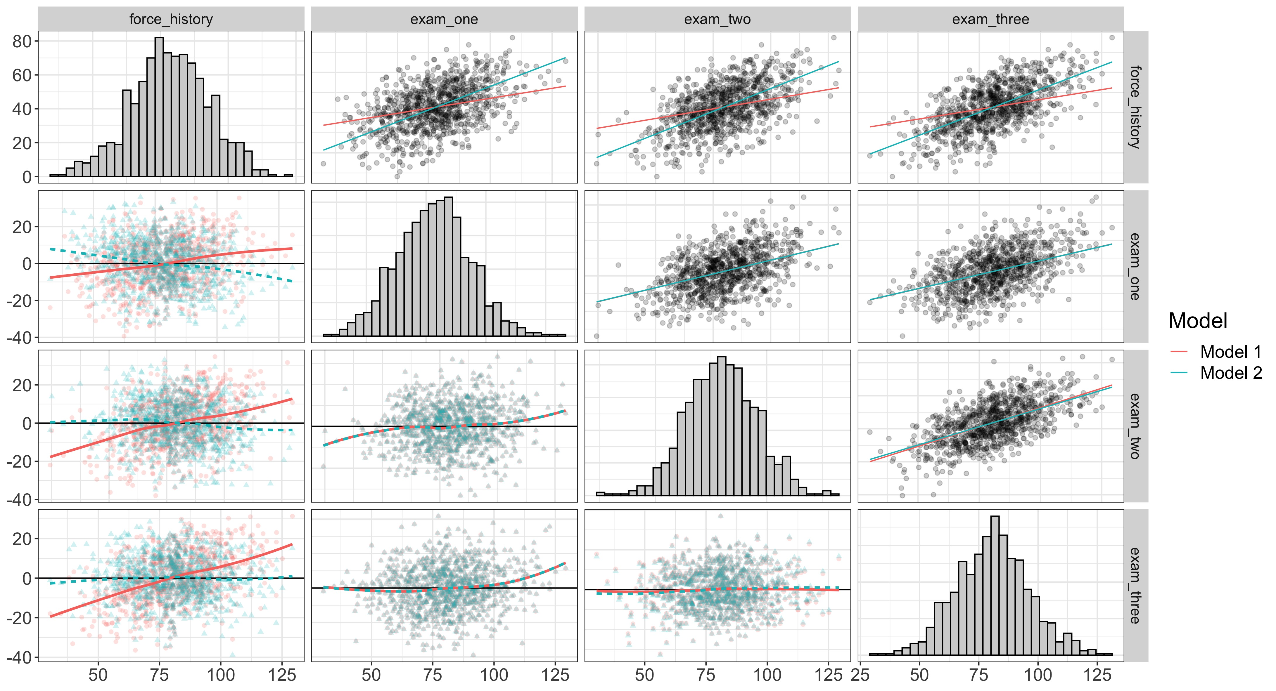
By golly, we can

Slide 44
Visualizing the measurement model
We have four variables
three observed
one latent
That’s a four dimensional plot
But let’s transform the data to long format
but first we transform the scale

Slide 45
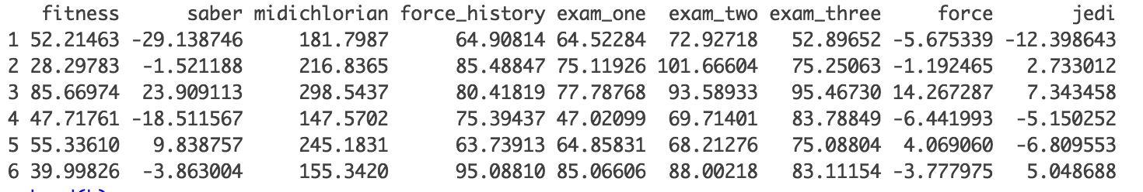
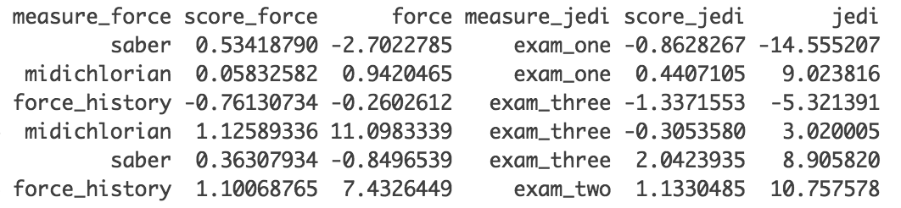
Wide to Long Format

Slide 46
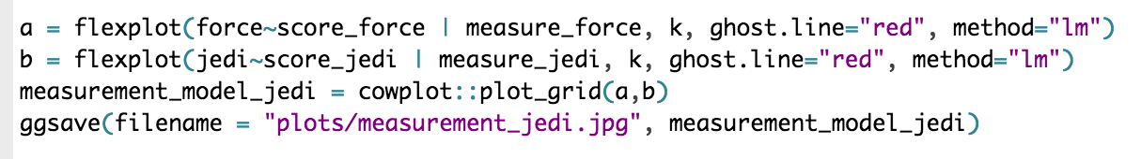
Flexplot

Slide 47
Nonlinear Models
These plots work great if the relationships are linear
But what if they’re not?

Slide 48
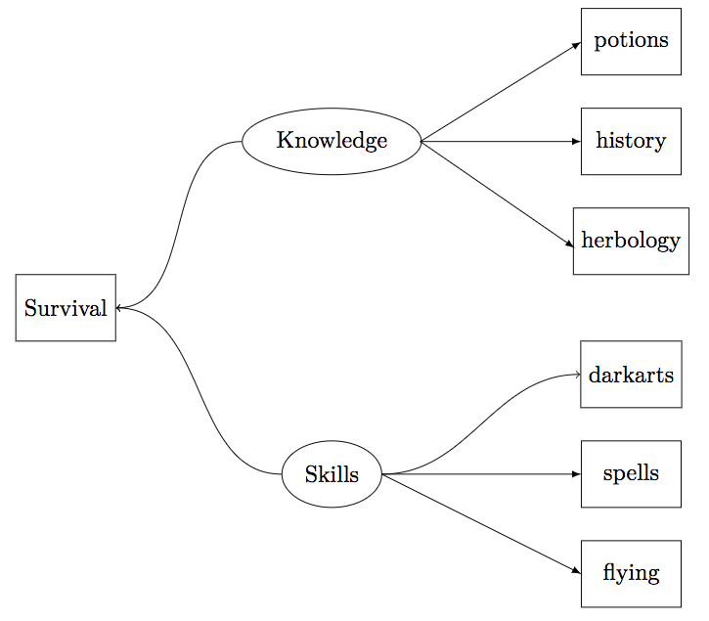
Example data
Hogwarts survival dataset
Nonlinear relationships between:
knowledge and survival
skills and survival
skills and darkarts

Slide 49
Problem
SEMs assume linear models
Can do a categorical model, but they suck
Wouldn’t it be nice if you could explicitly state each path?

Slide 50
Bayesian SEM
Much more flexible than regular SEM
Works with raw data
Able to estimate models regular SEM cannot
Naturally computes latent variables
But…

Slide 51
As of now…
There’s no general solution for visualizing these models
The implied model will depend on how the variables are related
So, I have to do more math ☹

Slide 52
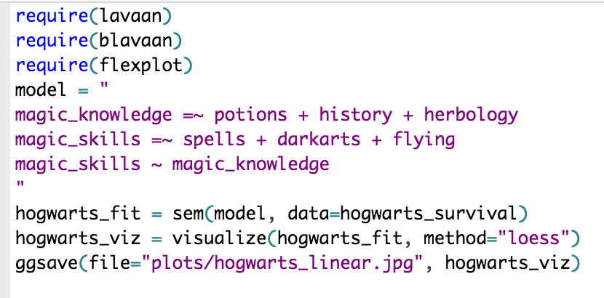
Naïve analysis

Slide 53
Naïve analysis

Slide 54
Let’s fit a Bayesian Model

Slide 55
While that’s running…
Let’s review the math here.

